Slide 1
The Mathematics of Physics at a Trillion Degrees
W. A. Horowitz
University of Cape Town
August 6, 2024
Based, in part, on Rothkopf, WAH, and Nordstrom, arXiv:2404.18676 [math.NA]

Slide 6
Activities
Research Programmes
Colloquia, webinars, mini-schools
Student bursaries
Internship Programme
Women’s Writing Retreat
Workshops
SATACS

Slide 7
Current Research Programmes
Quantitative finance
Machine learning in support of theoretical and computational science
Advancing biodiversity informatics and ecological modelling
Space-like mathematical structures and related topics in algebra, logic and computation
Advanced computational modelling of materials
Genomics, bioinformatics, and advanced medicine
Quantum technologies for sustainable development
New insights into astrophysics and cosmology with theoretical models confronting observational data

Slide 8
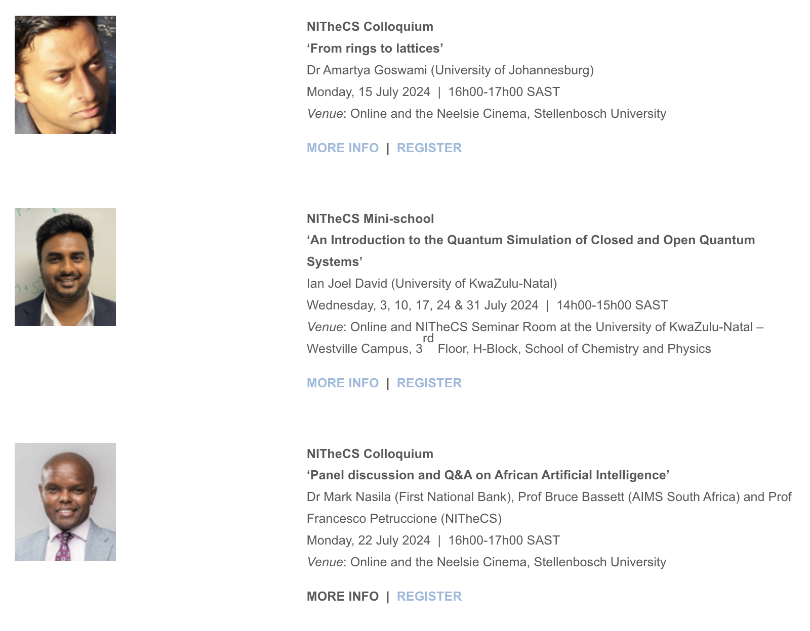
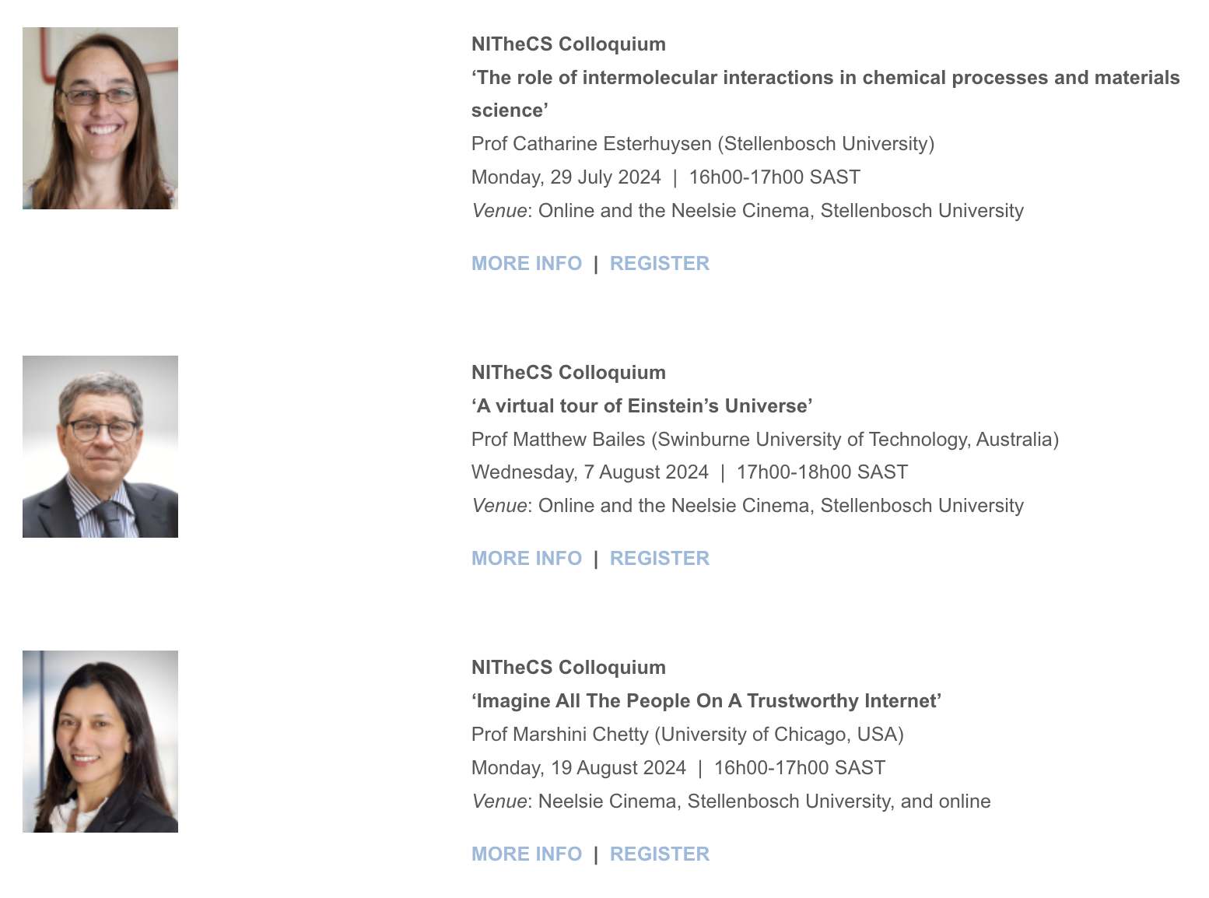
Recent Colloquia and Mini-School

Slide 9
Internship Programme
Support for students
Bursary + mobility
Support for postgraduate students supervising interns

Slide 12
South African Theory and Computation School (SATACS)
A decentralized, semi-virtual, national teaching programme in the themes of the National Institute for Theoretical and Computational Sciences (NITheCS)
Free for students
2nd Semester Courses:
Cosmology
Integrable Systems
Category Theory
Machine Learning: from Linear Regression to Deep Learning
Fundamentals of Trustworthy Machine Learning
Quantum Field Theory I & II
Details and to apply: https://nithecs.ac.za/south-african-theory-and-computational-school/

Slide 13
Introduction

Slide 14
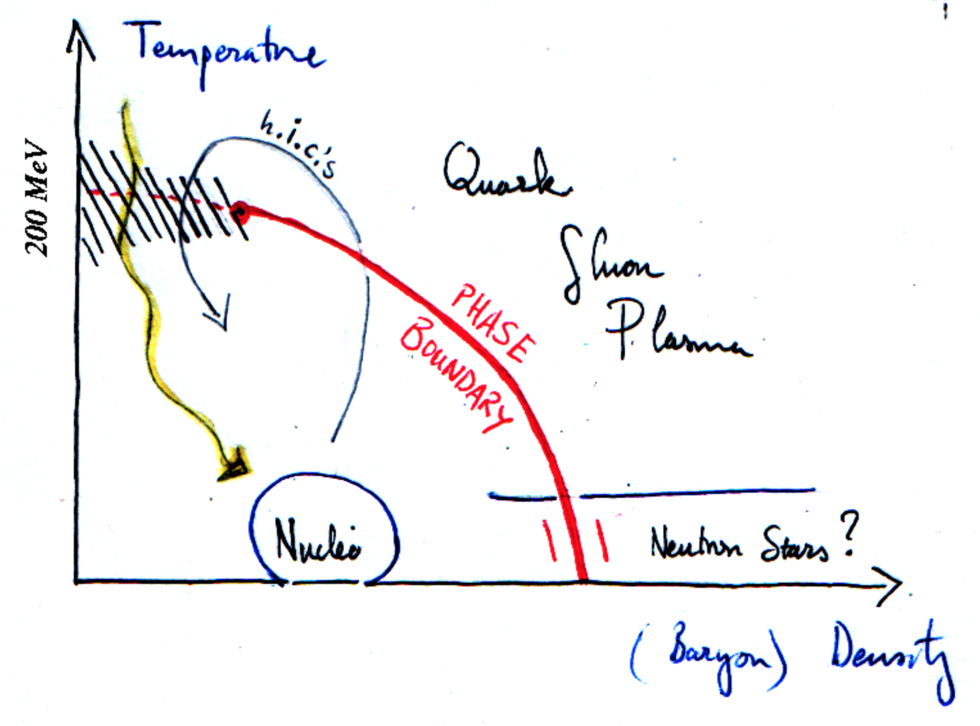
What Are We Studying?
The emergent, many-body properties of the strong force (i.e. nuclear matter)
Notes:
We’ll review these ideas in reverse order

Slide 15
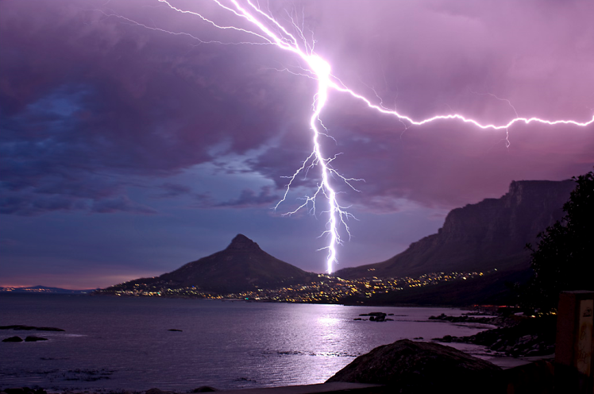
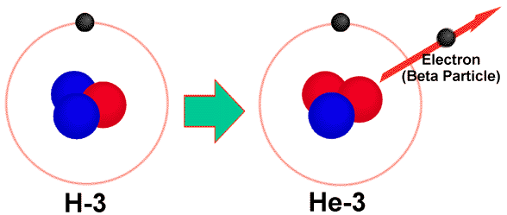
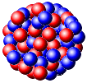
What does that mean? Forces
Gravity
Electromagnetism
starchild.gsfc.nasa.gov
John Maarschalk, travelblog.portfoliocollection.com
Weak
Strong
lhs.lps.org/staff/sputnam/chem_notes/tritium_decay.gif

Slide 16
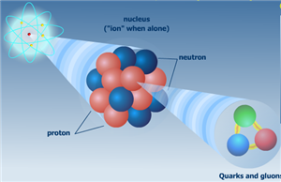
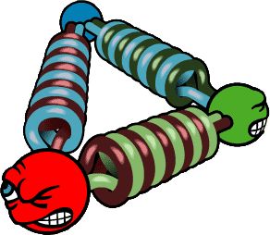
Zoom in on the Nucleus
Nuclei made up of protons and neutrons
p, n made up of quarks and gluons
Analogous to electrons and photons
Confined to p, n under normal conditions
nobelprize.org
Notes:
Nobel prize for asymptotic freedom. Confined for strong force; cf electromagnetic force for which we see the charges (electrons) and the force carriers (photons)

Slide 17
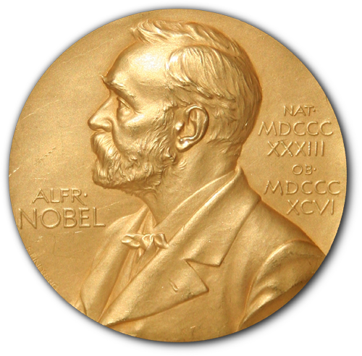
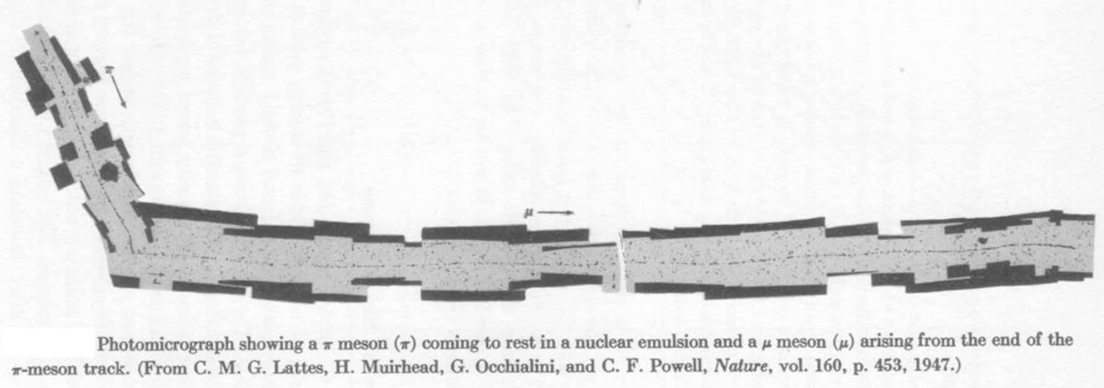
Strong Force
Described by quantum chromodynamics (QCD)
Extremely complicated, even today
Conservatively, 9 years’ of Nobel Prizes
Clay $1M Prize: prove ∃ mass gap
Notes:
QCD: three colors; only observe color neutral (white) objects like protons, neutrons, pions. Why?
14 Nobel Prizes in total
Fundamental unknown questions: mass gap, confinement, chiral symmetry breaking; proton mass
The smallest eigenstate of the Hamiltonian of non-Abelian quantum field theories is strictly greater than 0

Slide 18
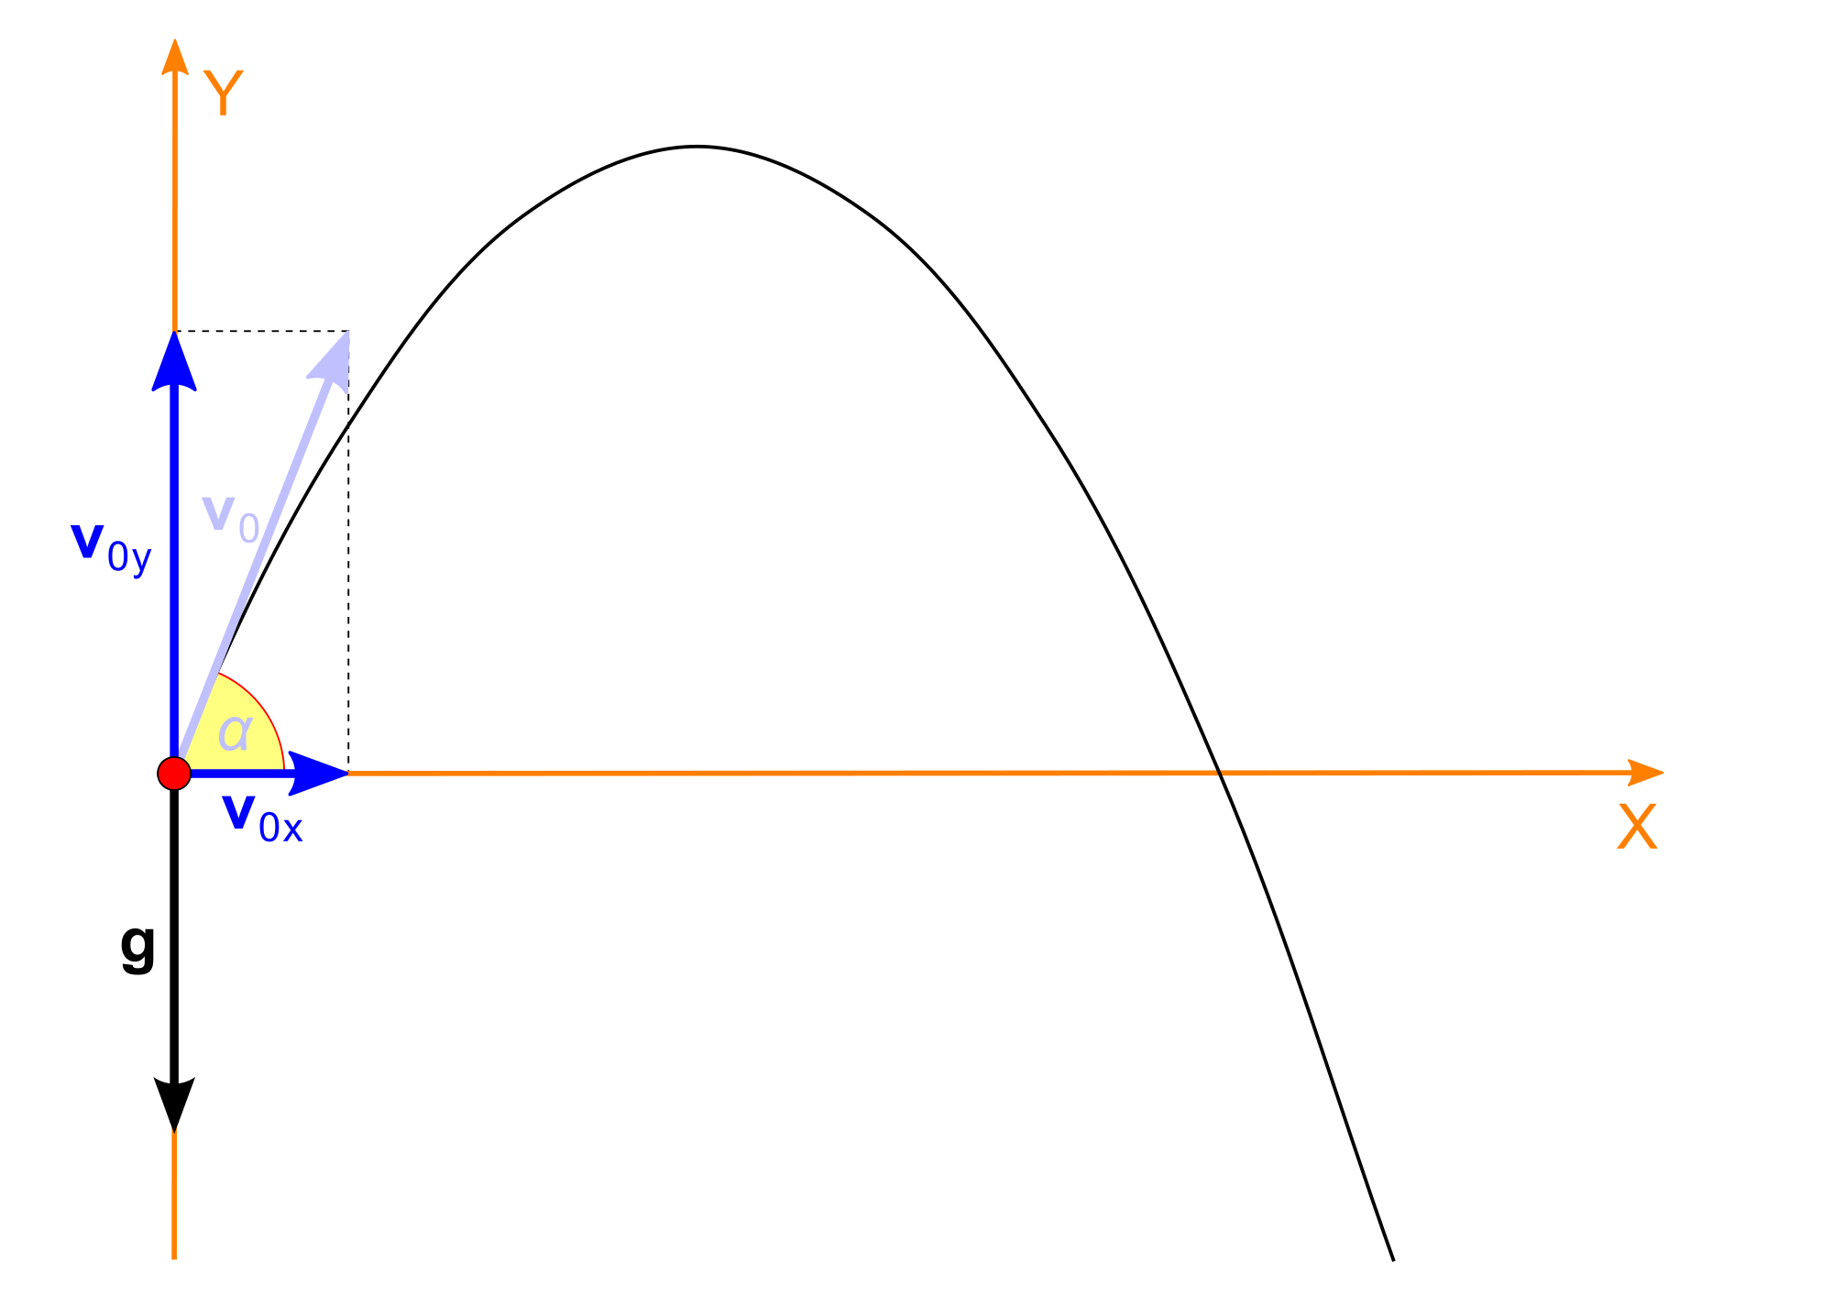
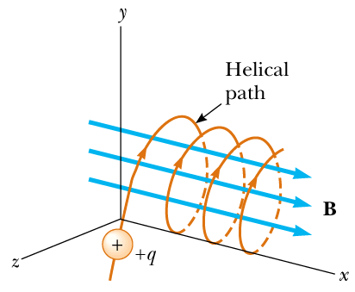
One vs Many
Much of physics is particle physics
What is the motion of a single object?
Notes:
Projectile motion; parabolic, t^2 motion of a cliff diver; an electrically charged particle in a magnetic field
Techniques of vector calculus. Tangent bundles of Lagrangian mechanics, the symplectic geometry of Hamilton’s formulation

Slide 19
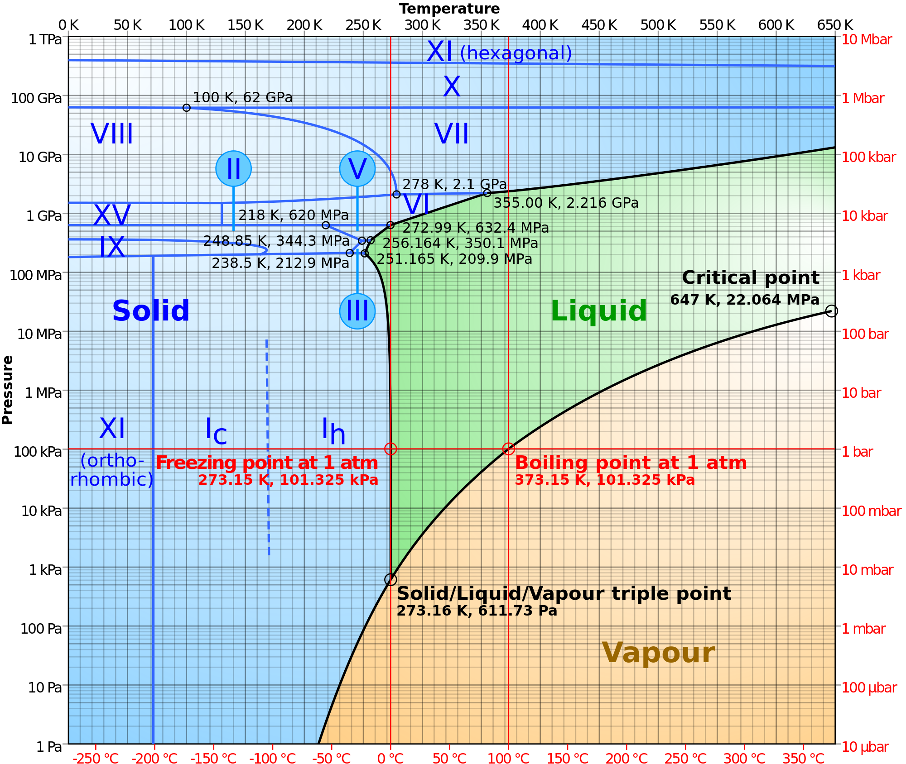
Many Body Behavior
How does Maxwell + QM lead to, e.g., water?
One H₂0 is very boring
Vibrates, rotates
Extremely well understood
Lots of H₂0 is very interesting
New props:
T, p, κ, c_{s}
Rich phase structure
Not at all understood
http://howyourbrainworks.net/content/
neutral-polar-and-electrically-charged-
particles
http://en.wikipedia.org/wiki/Phase_diagram
Notes:
Fundamental rules of the game are known and fixed. How does having a lot of stuff lead to complex dynamics one cannot easily predict from those simple fundamental rules?
Mathematics not well understood.

Slide 20
Emergent Phenomena
Many particles together can have collective behavior
Pressure, temperature, compressibility, waves
Notes:
Profoundly affects not only the questions we can ask, but also whether we can even answer those questions. For example, we won’t be able to answer the question: what will the temperature be on July 25, 2019 like we can for July 25, 2018. But we will have a good idea of the range of values.

Slide 21
Methods of Study

Slide 22
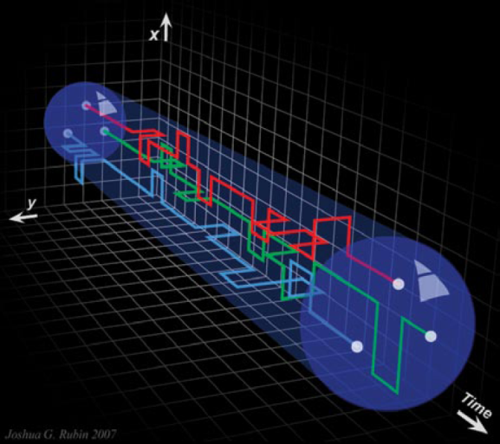
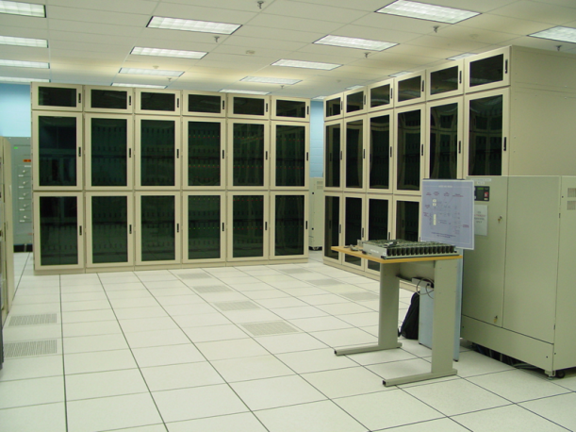
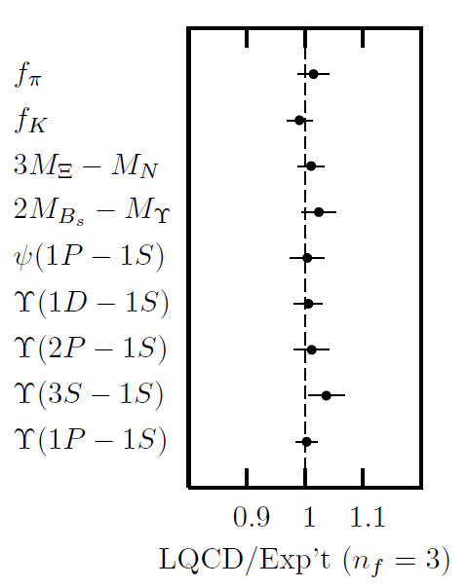
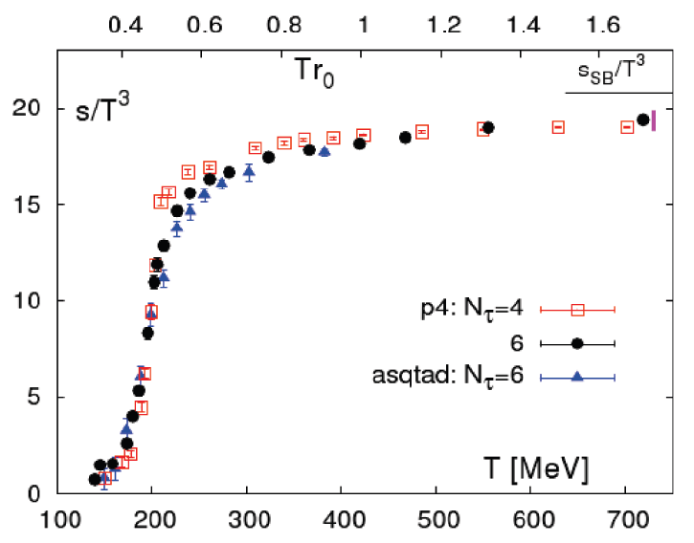
Methods of QCD Calculation I: Lattice
Long Range Plan, 2008
All momenta
Euclidean correlators
P, S, EoS, etc.
No dynamics
Spacetime symmetries broken
Cheng et al., PRD77 (2008)
Davies et al. (HPQCD),
PRL92 (2004)

Slide 23
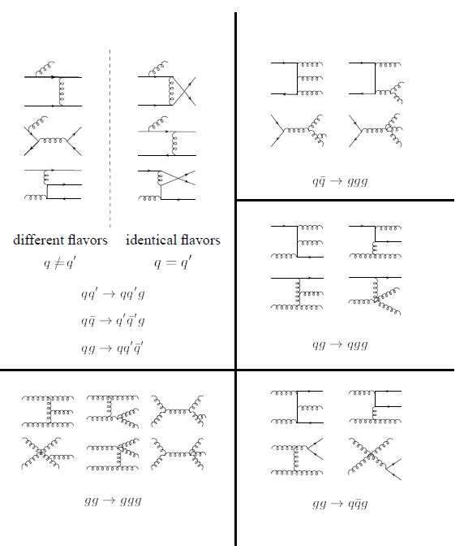
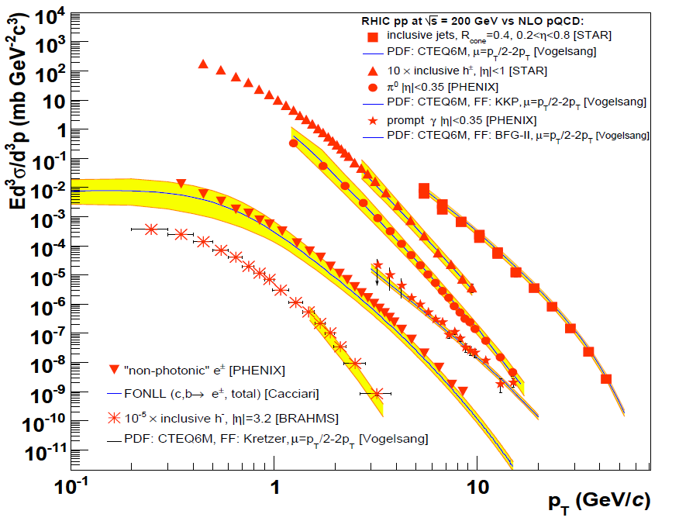
Methods of QCD Calculation II: pQCD
(perturbative QCD)
d’Enterria, 0902.2011
Jäger et al., PRD67 (2003)
Any quantity
Small coupling (requires large scale)
Notes:
Asymptotic expansion of a quantity

Slide 24
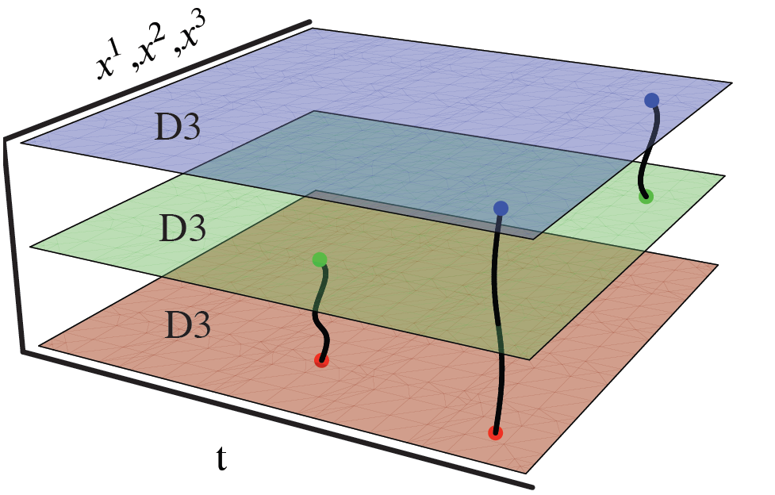
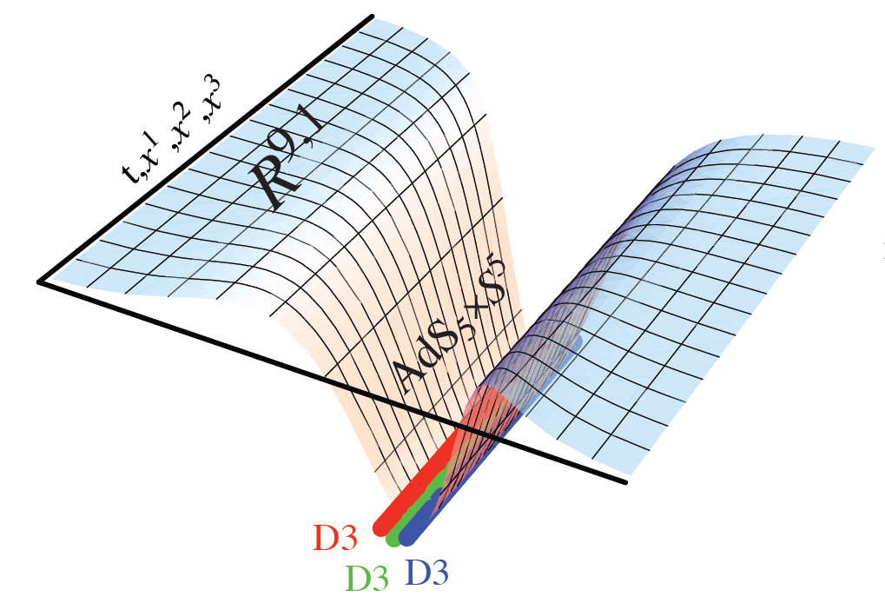
Methods III: AdS/CFT
Maldacena conjecture: SYM in d ⬄ IIB in d+1
Gubser, QM09
All quantities
N_{c} → ∞ SYM, not QCD
Probably not good approx. for p+p; maybe A+A?
Notes:
Use methods of differential geometry

Slide 25
Preferred Method:

Slide 26
Preserving Symmetries in Numerics

Slide 27
Symmetries are Fundamental
Noether:
Translations => conservation of momentum
Rotations => conservation of angular momentum
Time => conservation of energy
U(1) => conservation of charge
Weinberg:
Spacetime => possible particle content
Wigner program
Lorentz => possible field terms in Lagrangian
Wilson:
Effective field theories preserve symmetries of fundamental theory

Slide 28
Discretization Breaks Symmetries
Numerical evaluation of PDEs, actions, etc. usually discretizes space and/or time
Discretization breaks continuous symmetries into discrete ones
Lose exact energy/momentum conservation
Particle content changes
E.g. difficulties in lattice QCD
Is there a way to discretize but maintain symmetries?
Notes:
Fermion doubling problem in lattice QCD

Slide 29
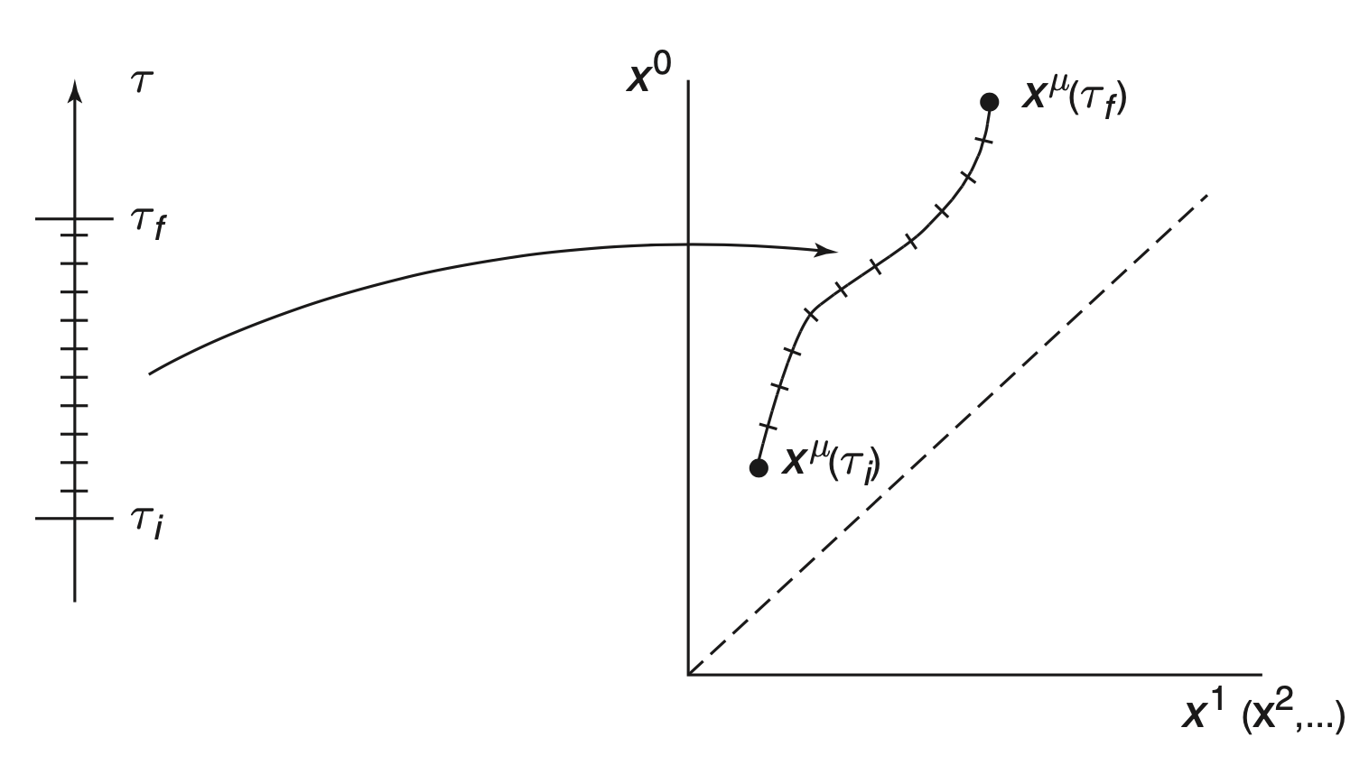
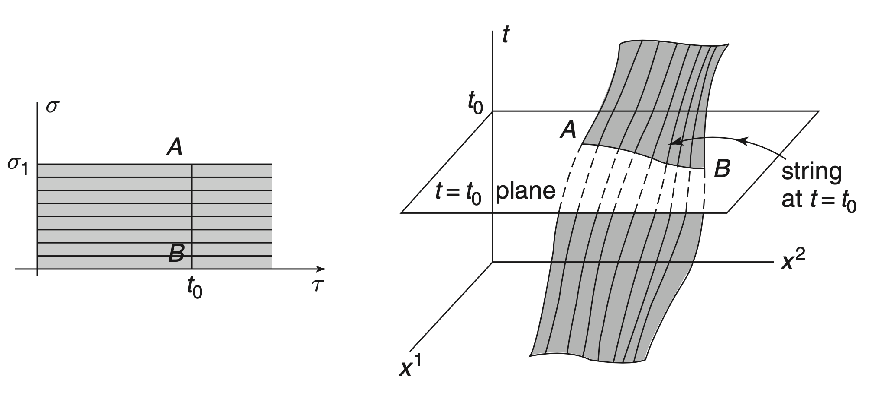
Reparameterization Invariant Actions
Physics shouldn’t depend on coordinates
=> reparameterization invariance of physics
Relativistic Point Particle
Relativistic String
Mapping from 1D parameter to 1D worldline in spacetime
Mapping from 2D parameter to 2D worldsheet in spacetime

Slide 30
Non-relativistic Limit
Include a potential for point particle
For small velocities, v<<c, expand relativistic point particle action
Conclusion: ½ is possibly a general sign of expansion from reparam inv action

Slide 31
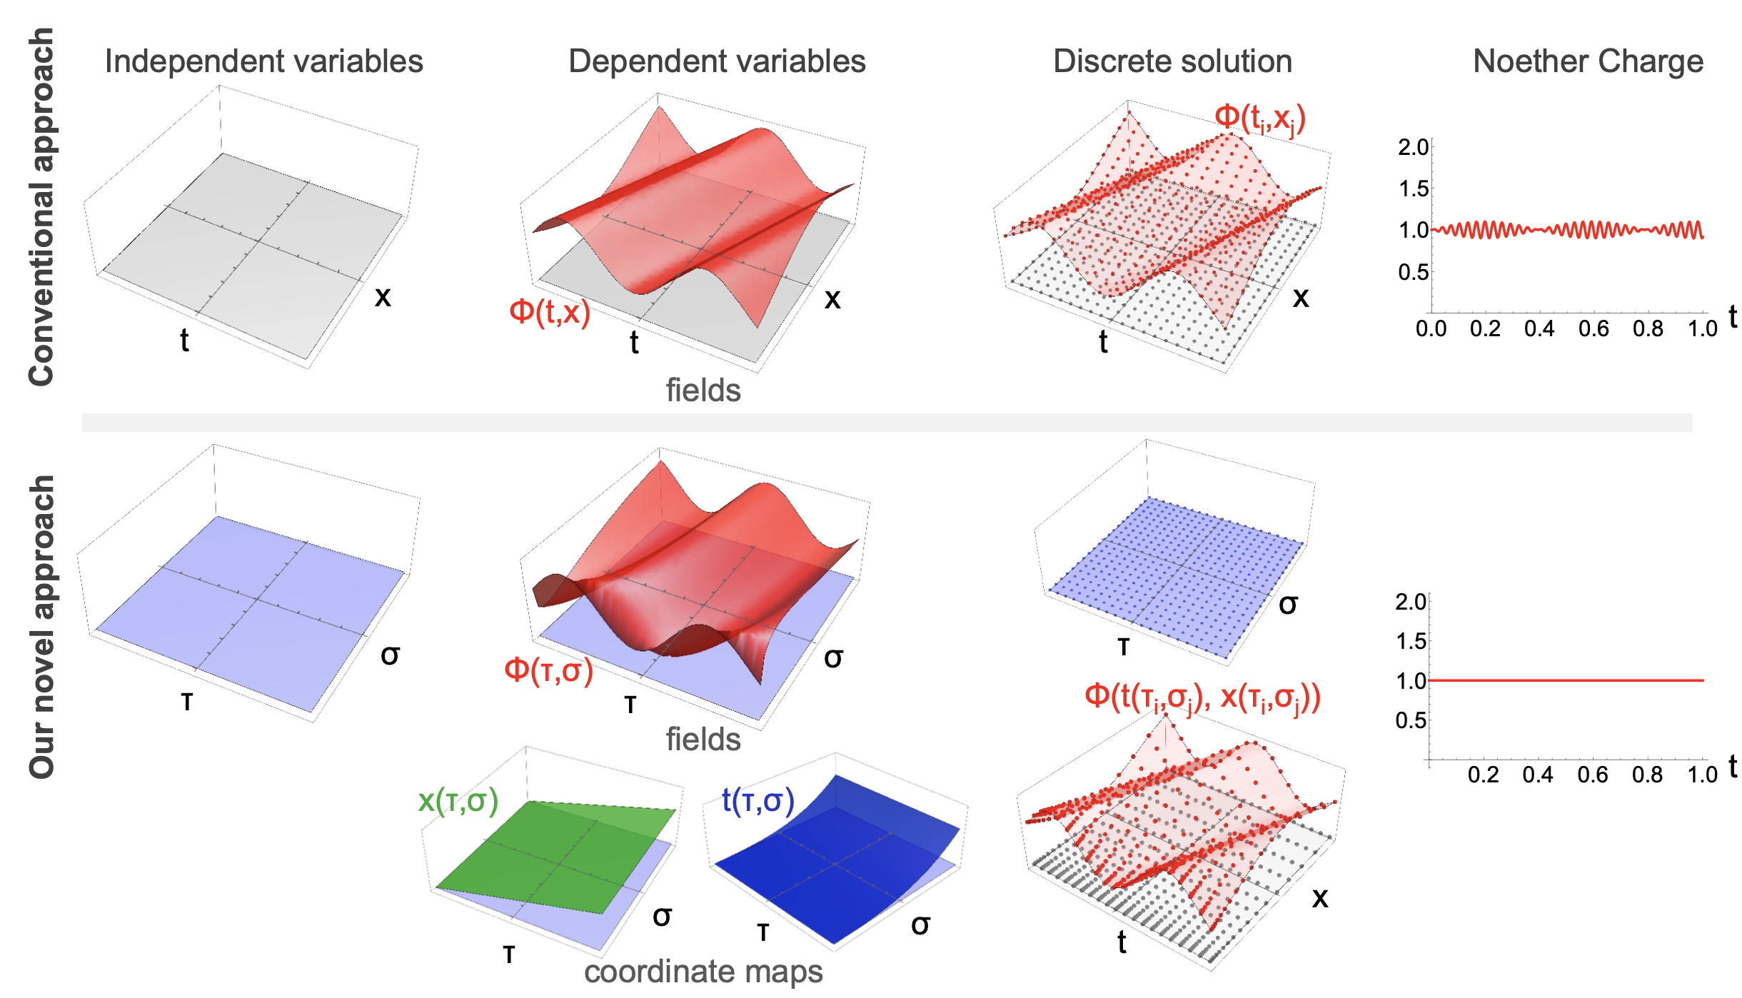
Dynamical Coordinates
Idea: make the coordinates that fields depend on themselves dynamical
Discretize the parameter space that the coordinates depend upon

Slide 32
Specific Example: Waves
Motivation:
Canonical 2nd order PDE
Extraordinary importance
Fundamental physics
Industry applications
…
Treatment of boundary conditions open problem
No good method to allow waves to escape finite region

Slide 33
Specific Example: Waves in a Box
Take field as massless scalar
Include coordinates in dynamics
Combine with some large parameter T
T similar to m in relativistic point particle action
Expansion in T reproduces original actions up to (1/T²)

Slide 34
Numerical Results 1/3
For simplest first attempt, take t(τ,σ), x=σ
Can solve modified Euler-Lagrange PDEs or by extremizing S
Wave solution correct to sub-percent
Rothkopf, WAH, and Nordström, arXiv:2404.18676

Slide 35
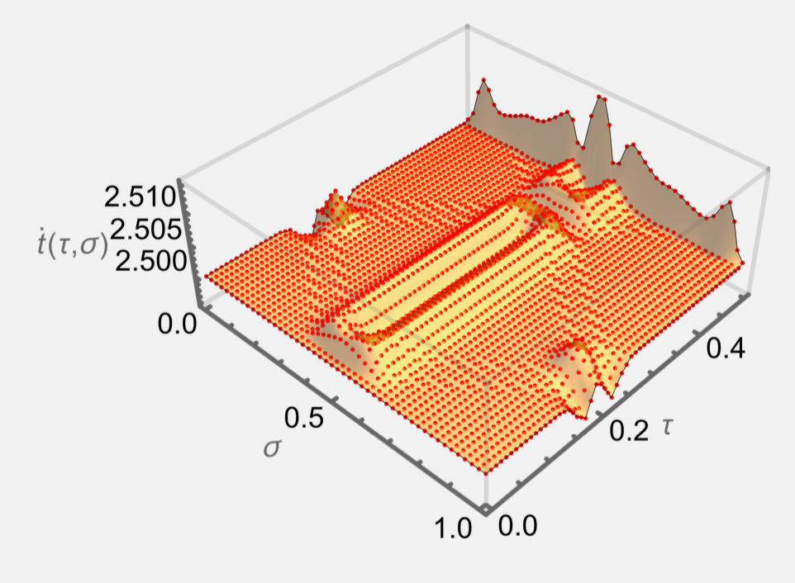
Numerical Results 2/3
Solution automatically includes mesh refinement:
Time speeds up in regions of small wave variation
Time slows down in regions of large wave variation
Rothkopf, WAH, and Nordström, arXiv:2404.18676

Slide 36
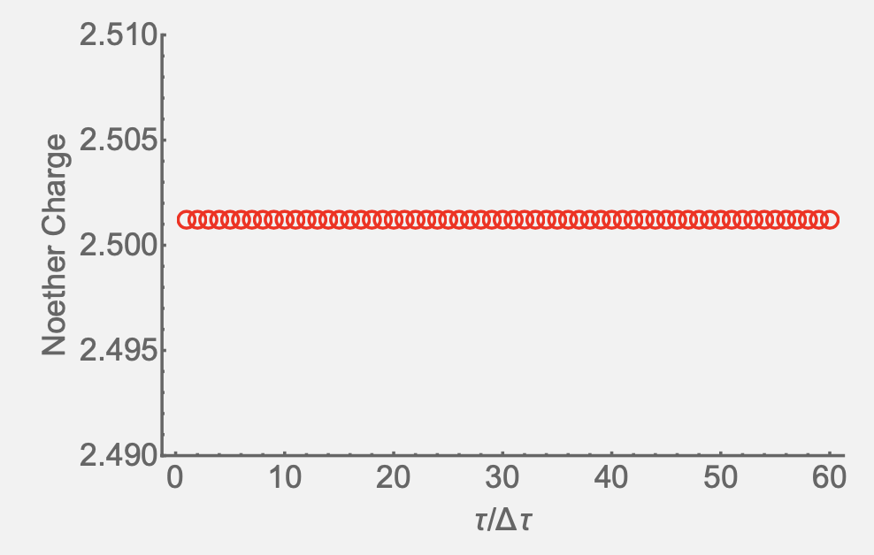
Numerical Results 3/3
Exact energy conservation (to global accuracy of simulation, Δ~10⁻⁶)
Rothkopf, WAH, and Nordström, arXiv:2404.18676

Slide 37
Conclusions and Outlook
Novel action including coordinates in dynamics exactly preserves spacetime symmetry even after discretization
Future work includes
generalizing to t(τ,σ) and x(τ,σ); see center of mass preservation (from boost invariance)
including additional spatial dimensions; see angular momentum conservation
generalization of boundary value conditions
significant importance in numerical PDEs

